Slide 1
Automatic Precipitation Detection System for Car
REVIEW 3
TEAM 5
19BLC1179 Ahona Saha
19BEC1180 Aman Sahu
19BEC1398 P Uday Bhaskar

Slide 2
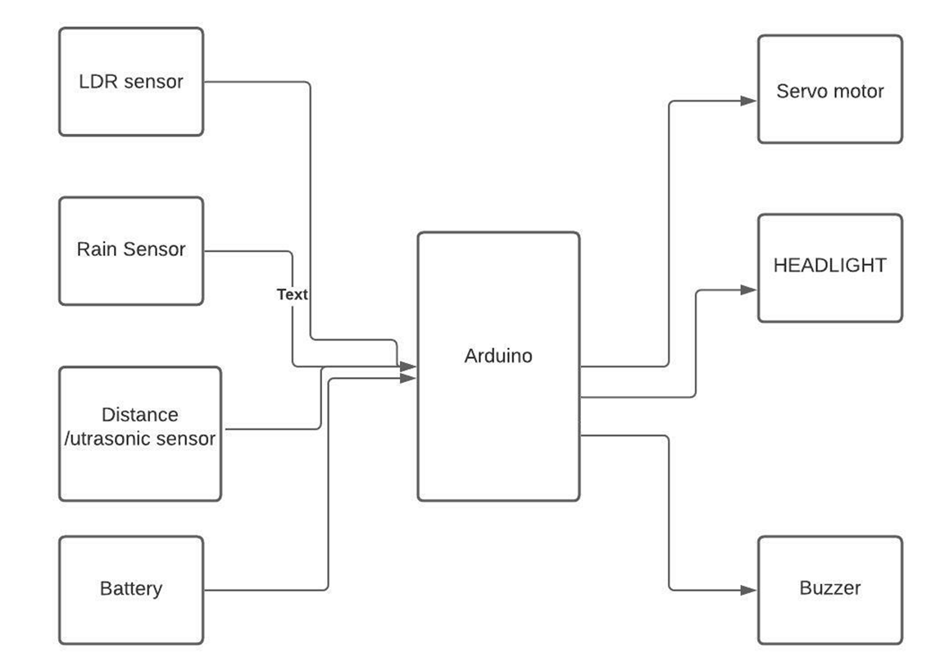
Block Diagram

Slide 3
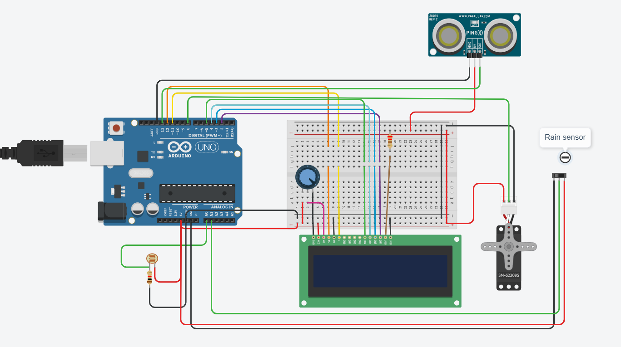
Circuit Diagram of Proposed Model

Slide 4
Software and Hardware Used
Software : Arduino IDE
Hardware : Arduino
Rain Sensor
LDR
LED
Ultra sonic sensor
Buzzer
BreadBoard
Servo motor and Jumper Wires

Slide 5
API USED
(APIs for working with the LCD)
LiquidCrystal lcd(rs, enable, d4, d5, d6, d7) :- To use the LiquidCrystal library, create a named LiquidCrystal object. In this case the object is lcd.
· lcd.begin(cols, rows) :- Initializes the interface to LCD, and specifies dimensions.
o cols: Initialize column position i.e., starting column to display the first character/value.
o rows: Initialize row position i.e., starting row to display/print the first character.
· lcd.setCursor(col, row) :- Position the LCD cursor to set row and column value across 16x2.
- cols: Set column position i.e., column to display the character/value input.
- rows: Set row position i.e., row to display/print the character input.
· lcd. clear() :- Clears the LCD screen and positions the cursor on upper-left corner.
· lcd.print(data)/lcd.write(data) :- The character to write to the display.
- data: The value/character that needs to be displayed onto the LCD.

Slide 6
(APIs for working with the Servo)
· servo.attach(pin) :- Check whether the Servo variable is attached to the Arduino pin. Return true if the servo is attached topin; false otherwise.
- pin: the number of the Arduino pin that the servos attached to.
· servo.write(angle) :- Writes a value to the servo, controlling the shaft accordingly.
- angle: The angle value to write to the servo, from 0 to 180 degrees.

Slide 7
· pinMode(pin, mode) :- Configures the specified pin to either input or output.
- pin: the Arduino pin number to set the mode of.
- mode: INPUT, OUTPUT, or INPUT_PULLUP.
· analogRead(pin) :- Reads the current state of the given pin, HIGH or LOW.
- pin: the Arduino pin number.
· digitalWrite(pin, value) :- Write a HIGH or a LOW value to a digital pin.
- pin: the Arduino pin number.
- value: HIGH or LOW.
· delay(ms) :- Pauses the program for the amount of time (in milliseconds).
- ms: the number of milliseconds to pause.

Slide 8
CODE:
#include <Servo.h>
Servo myservo;
//distance sensor....
#define echoPin 2
#define trigPin 3
long duration;
int distance;
//LDR...............
const int ldrPin = A0;
//LED......
const int ledPin1=9;
const int ledPin2=10;
const int ledPin3=11;
const int ledPin4=12;
//buzzer..........
int buzzPin=4;

Slide 9
int pos = 0;
int sensorValue = 0;
void setup() {
Serial.begin(9600);
pinMode(trigPin,OUTPUT);
pinMode(echoPin,INPUT);
pinMode(buzzPin, OUTPUT);
pinMode(ledPin1, OUTPUT);
pinMode(ledPin2, OUTPUT);
pinMode(ledPin3, OUTPUT);
pinMode(ledPin4, OUTPUT);
pinMode(ldrPin, INPUT);
myservo.attach(7);
Serial.println("Intelligent Rain");
Serial.println("Sensing CarViper");
delay(3000);
Serial.println("Rainfall");
Serial.println("Intensity-"); }

Slide 10
void loop(){
// Duration will be the input pulse width and distance will be the distance to the obstacle in centimeters
int duration, distance;
digitalWrite(trigPin, HIGH); // Output pulse with 1ms width on trigPin
delay(1);
digitalWrite(trigPin, LOW);
duration = pulseIn(echoPin, HIGH); // Measure the pulse input in echo pin
distance = (duration/2) / 29.1; // Distance is half the duration divided by 29.1 (from datasheet)
// if distance less than 0.5 meter and more than 0 (0 or less means over range)
if (distance <= 50 && distance >= 0) {
digitalWrite(buzzPin, HIGH); // Buzz
} else {
digitalWrite(buzzPin, LOW); // Don't buzz
}

Slide 11
//......................
int ldrStatus = analogRead(ldrPin);
if (ldrStatus <= 200&&ldrStatus > 50) {
digitalWrite(ledPin1, HIGH);
digitalWrite(ledPin2, HIGH);
digitalWrite(ledPin3, LOW);
digitalWrite(ledPin4, LOW);
Serial.print("Its DARK, Turn on the LED : ");
Serial.println(ldrStatus);
} else if(ldrStatus < 50){
digitalWrite(ledPin1, HIGH);
digitalWrite(ledPin2, HIGH);
digitalWrite(ledPin3, HIGH);
digitalWrite(ledPin4, HIGH);
Serial.print("Its VERY DARK, Turn on the LED : ");
Serial.println(ldrStatus);}

Slide 12
else{
digitalWrite(ledPin1, LOW);
digitalWrite(ledPin2, LOW);
digitalWrite(ledPin3, LOW);
digitalWrite(ledPin4, LOW);
Serial.print("brightg: ");
Serial.println(ldrStatus);}
//.rain...................................
sensorValue = analogRead(A3);
Serial.println(sensorValue);
if(sensorValue>800){
myservo.write(180);
Serial.print(" NO RAIN ");
delay(1000);
}

Slide 13
if(sensorValue<=800 && sensorValue>600){
Serial.print("Low Rain");
for (pos = 180; pos >= 0; pos-=1) {
myservo.write(pos);
delay(3); }
for (pos = 0; pos <= 180; pos+=1) {
myservo.write(pos);
delay(3); }
delay(2000);}
if(sensorValue<=600 && sensorValue>460){
Serial.print("AMOUNT: MEDIUM ");
for (pos = 180; pos >= 0; pos-=1) {
myservo.write(pos);
delay(3); }

Slide 14
for (pos = 0; pos <= 180; pos+=1) {
myservo.write(pos);
delay(3); }
delay(1000); }
if(sensorValue<460){
Serial.print("AMOUNT: HIGH ");
for (pos = 180; pos >= 0; pos-=1) {
myservo.write(pos);
delay(3); }
for (pos = 0; pos <= 180; pos+=1) {
myservo.write(pos);
delay(3); }
delay(100); }
}

Slide 15
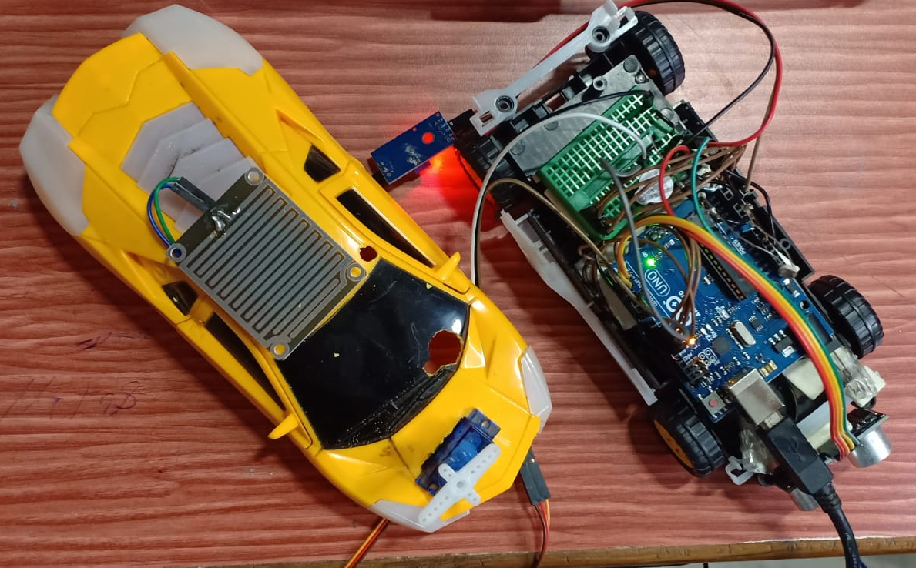

Slide 16
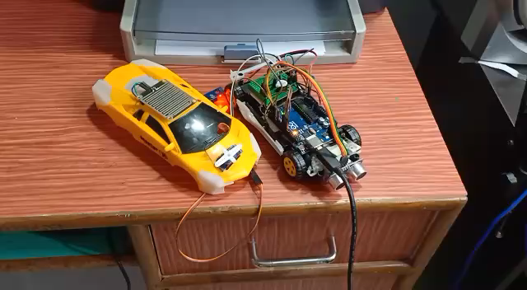
Short Demo Video:

Slide 17
THANK YOU

